Slide 1
Splash Screen

Slide 2
Lesson Menu
Then/Now
New Vocabulary
Key Concept: Solving Systems of Inequalities
Example 1: Intersecting Regions
Example 2: Separate Regions
Example 3: Real-World Example: Write and Use a System of Inequalities
Example 4: Find Vertices

Slide 3
Then/Now
You solved systems of linear equations using tables and graphs. (Lesson 3–1)
Solve systems of inequalities by graphing.
Determine the coordinates of the vertices of a region formed by the graph of a system of inequalities.

Slide 4
Vocabulary
system of inequalities

Slide 5
Concept

Slide 6
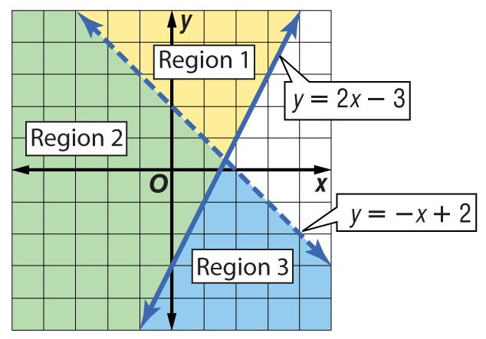
Example 1
Intersecting Regions
A. Solve the system of inequalities by graphing.
y ≥ 2x – 3 y < –x + 2
Solution of y ≥ 2x – 3 → Regions 1 and 2
Solution of y < –x + 2 → Regions 2 and 3

Slide 7
Example 1
Intersecting Regions
A.
Answer: The intersection of these regions is Region 2, which is the solution of the system of inequalities. Notice that the solution is a region containing an infinite number of ordered pairs.

Slide 8
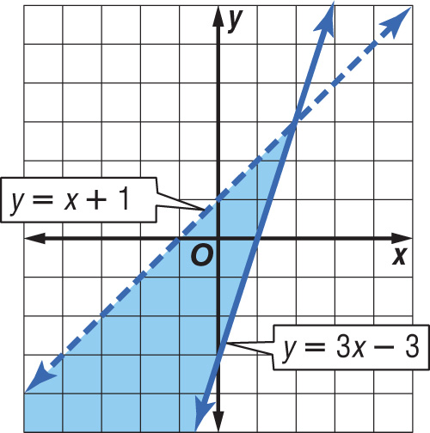
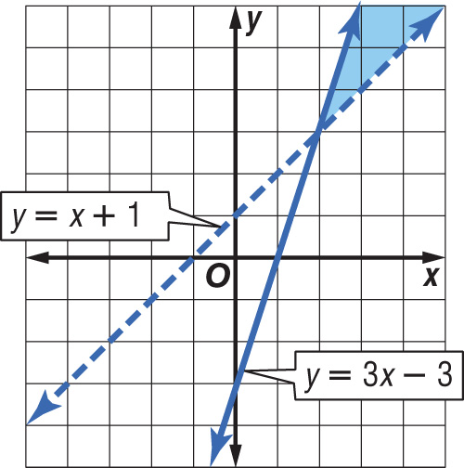
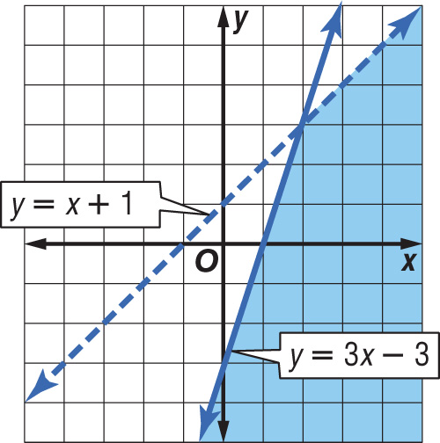
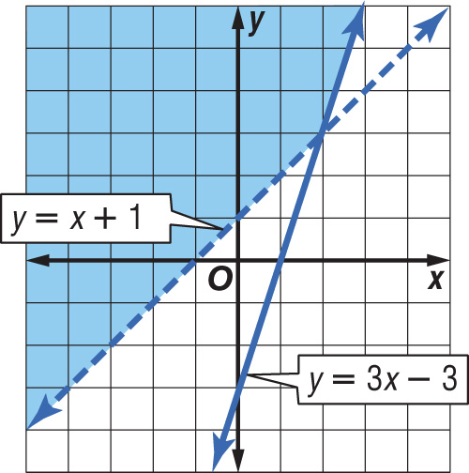
Example 1
Solve the system of inequalities by graphing. y ≤ 3x – 3 y > x + 1
A. B.
C. D.
A
B
C
D

Slide 9
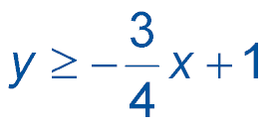
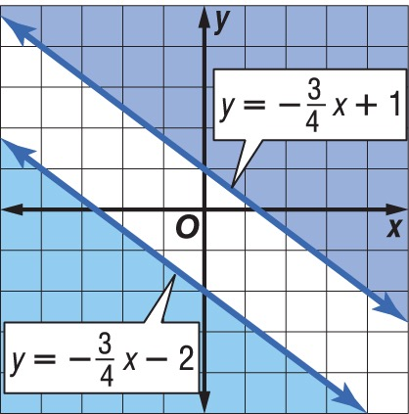
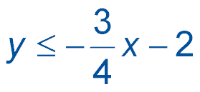
Example 2
Separate Regions
Solve the system of inequalities by graphing.
Graph both inequalities.
The graphs do not overlap, so the solutions have no points in common and there is no solution to the system.
Answer: The solution set is Ø.

Slide 10
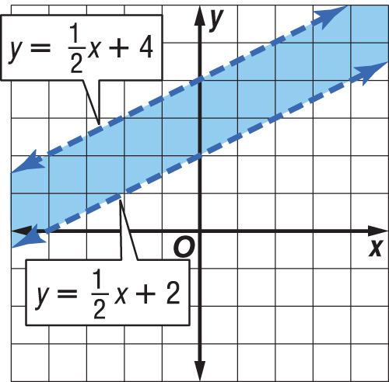
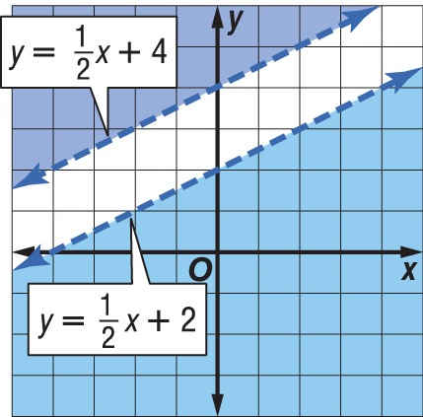
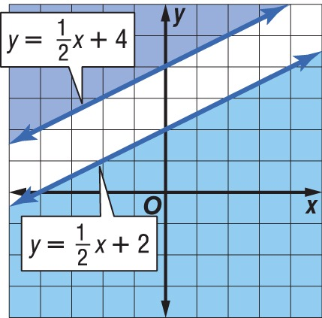
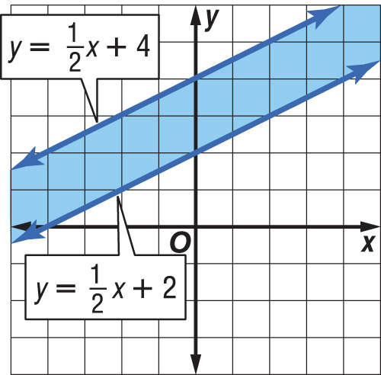
Example 2
Solve the system of inequalities by graphing.
A. B.
C. D.
A
B
C
D

Slide 11
Example 3
Write and Use a System of Inequalities
MEDICINE Medical professionals recommend that patients have a cholesterol level c below 200 milligrams per deciliter (mg/dL) of blood and a triglyceride level t below 150 mg/dL. Write and graph a system of inequalities that represents the range of cholesterol levels and triglyceride levels for patients.
Let c represent the cholesterol levels in mg/dL.
It must be less than 200 mg/dL. Since cholesterol levels cannot be negative, we can write this as 0 ≤ c < 200.

Slide 12
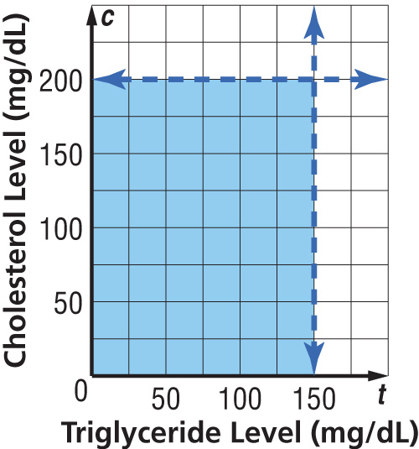
Example 3
Write and Use a System of Inequalities
Let t represent the triglyceride levels in mg/dL. It must be less than 150 mg/dL. Since triglyceride levels also cannot be negative, we can write this as 0 ≤ t < 150.
Graph all of the inequalities. Any ordered pair in the intersection of the graphs is a solution of the system.
Answer: 0 ≤ c < 200 0 ≤ t < 150

Slide 13
Example 3
A category 3 hurricane has wind speeds of 111-130 miles per hour and a storm surge of 9-12 feet above normal. Write and graph a system of inequalities to represent this situation.

Slide 14
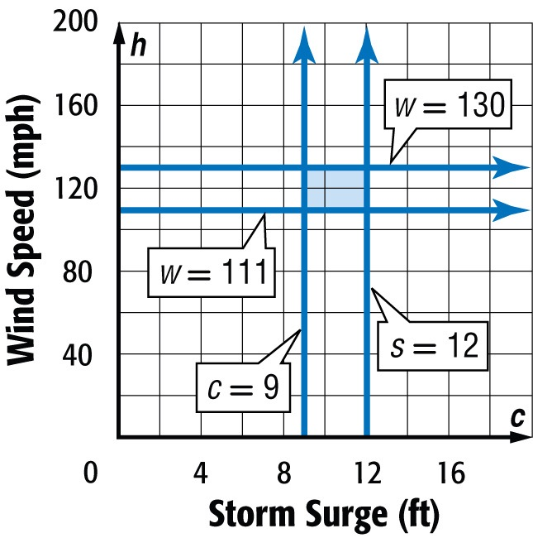
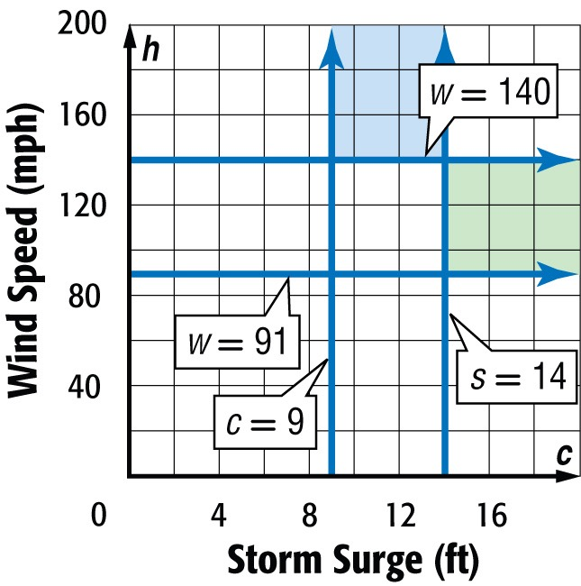
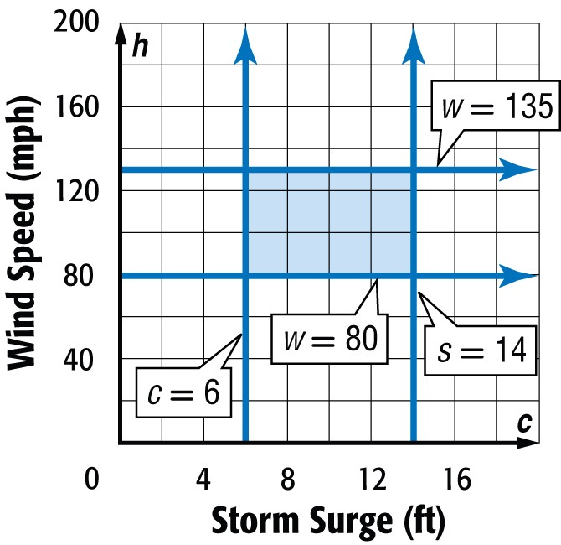
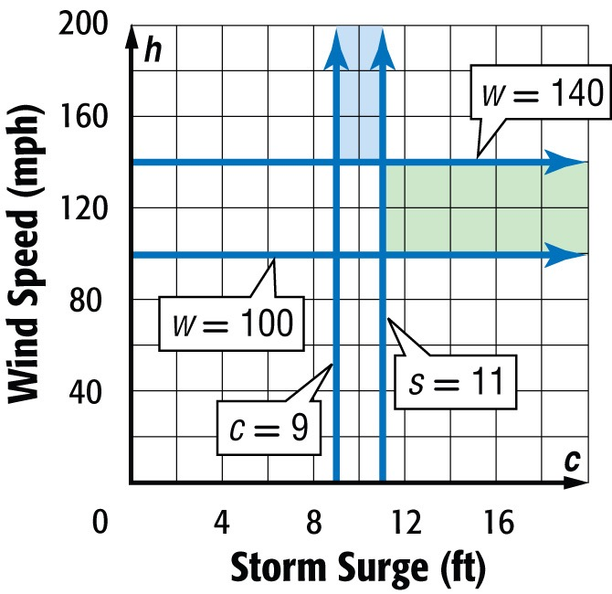
Example 3
Which graph represents this?
A. B.
C. D.
A
B
C
D

Slide 15
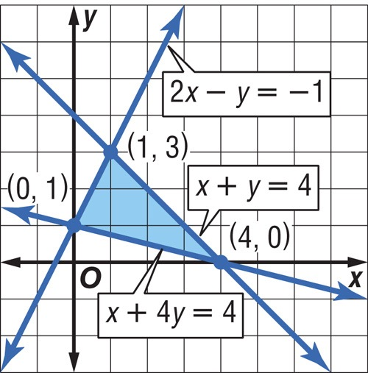
Example 4
Find Vertices
Find the coordinates of the vertices of the figure formed by 2x – y ≥ –1, x + y ≤ 4, and x + 4y ≥ 4.
Graph each inequality. The intersection of the graphs forms a triangle.
Answer: The vertices of the triangle are at (0, 1), (4, 0), and (1, 3).

Slide 16
Example 4
Find the coordinates of the vertices of the figure formed by x + 2y ≥ 1, x + y ≤ 3, and –2x + y ≤ 3.
A. (–1, 0), (0, 3), and (5, –2)
B. (–1, 0), (0, 3), and (4, –2)
C. (–1, 1), (0, 3), and (5, –2)
D. (0, 3), (5, –2), and (1, 0)
A
B
C
D

Slide 17
End of the Lesson

